Slide 1

Introduction to Machine Learning in Python
G. Parkes, T. Rampat, S. Senior
Download VM at: http://www.southampton.ac.uk/~ngcmbits/virtualmachines/

Slide 2
Overview
Introduction to Machine Learning
Practical 1 – Decision Trees/K-Means
Regression, Preprocessing and Fitting
Practical 2 – Regression
Image Classification, Deep Learning
Practical 3 – TensorFlow

Slide 3
Assumptions
Solid understanding of Python.
No/Little understanding of Machine Learning.
Exposure to Pandas and NumPy beneficial.
Knowledge of the Jupyter Notebook and a Python IDE like Spyder will be beneficial.

Slide 4
Machine Learning – What is it?
A subset of Computer Science and derived from Artificial Intelligence (AI)
At it’s heart a probability generator, with strong ties to statistics/mathematical optimisation.
Improving the probability score taken as ‘learning’. Uses this learnt data to ‘predict’ on new data.
Examples of use: Spam Filtering, Character Recognition, Computer Vision, Search Engines, Social Media

Slide 5
Machine Learning – The Problem
def detect_edges(‘image’):
# lots of code
def count_colour_pixels(‘image’):
# lots of code
def guess_texture(‘image’):
# lots of code
def define_fruit(‘image’):
# lots of code
Apples and Oranges

Slide 6
Machine Learning – The solution
f(X) = y
where X is a matrix of input, independent variables, and y is a vector of output, dependent variables that classify X.
Sepal Length | Sepal Width | Petal Length | Petal Width | Species
5.1 | 3.5 | 1.4 | 0.2 | I. setosa
4.9 | 3.0 | 1.4 | 0.2 | I. setosa
4.7 | 3.2 | 1.3 | 0.2 | I. setosa
7.0 | 3.2 | 4.7 | 1.4 | I. versicolor
6.4 | 3.2 | 4.5 | 1.5 | I. versicolor
6.3 | 3.3 | 6.0 | 2.5 | I. virginica
Taken from Fisher's Iris data set

Slide 7
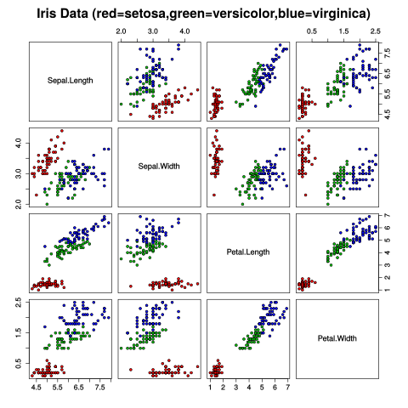
Iris Dataset
Each species is shaded a different colour
Clear distinct patterns emerge
ML trained to learn these patterns
Applies it to new information when available
By Nicoguaro - Own work, CC BY 4.0, https://commons.wikimedia.org/w/index.php?curid=46257808

Slide 8
Machine Learning – Going slightly deeper
Three broad categories:
Supervised Learning – Presented with example inputs and corresponding outputs, given by a ‘teacher’.
Unsupervised Learning/Data Mining – No labels given to inputs, computer infers features.
Reinforcement Learning – Interacts with a dynamic environment where it must perform a certain goal, feedback via rewards/punishments.

Slide 9

Decision Trees
Decision Trees convert the column data into a tree hierarchy where each leaf node will refer to one of the labels that can be identified with the feature data.
Each branch tries to classify with a condition based on one of the feature columns.
More columns/data leads to more complex tree structure.
By Stephen Milborrow - Own work, CC BY-SA 3.0, https://commons.wikimedia.org/w/index.php?curid=14143467

Slide 10

K-Nearest Neighbours
With Nearest Neighbour classifiers, we can use the Euclidean distance as a weight between points as a means of clustering features and identifying them.
Not to be confused with k-means clustering; this is a classifier and not a clustering algorithm.
The unidentified points are classified according to the label of the majority of nearest neighbours.
By Antti Ajanki AnAj (Own work) [GFDL (http://www.gnu.org/copyleft/fdl.html), CC-BY-SA-3.0 (http://creativecommons.org/licenses/by-sa/3.0/) or CC BY-SA 2.5-2.0-1.0 (http://creativecommons.org/licenses/by-sa/2.5-2.0-1.0)], via Wikimedia Commons

Slide 11
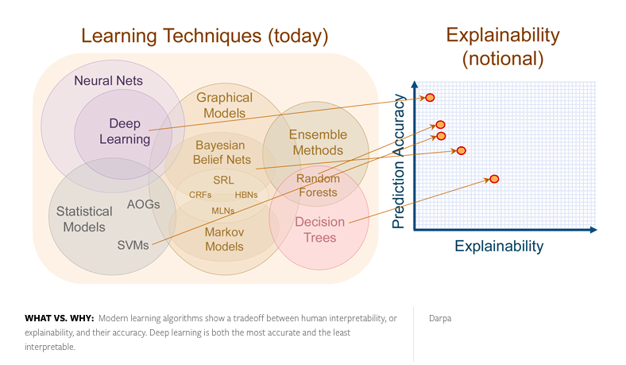
Understandability of Machine Learning
Taken from Nautil.us

Slide 12
Scikit-Learn
A package in Python programming language. Part of the Anaconda Distribution.
Built on NumPy, SciPy and MatPlotLib libraries.
Open source, commercially usable.
Simple to set up for most applications, very powerful functionality.
Highly accessible.

Slide 13
Scikit-Learn
Name of Method | Example use | Algorithm
Classification | Spam Detection, Image Recognition | SVM, random forest, nearest neighbours
Regression | Drug response, stock prices | SVR, Ridge regression, LASSO
Clustering | Customer segmentation, grouping experiment outcomes | K-Means, Spectral Clustering, mean-shift
Dimensionality Reduction | Visualization, increased efficiency | PCA, Feature Selection, non-negative matrix factorisation
Model Selection | Improved accuracy via parameter tuning | Grid search, cross validation, metrics
Preprocessing | Transforming data (i.e text) for use in ML algorithms | Feature Extraction
Taken from scikit-learn.org

Slide 14
Practical – Getting Started
If the files aren’t on the VM, clone them from GitHub using ‘git clone https://github.com/gregparkes/ML_Intro.git’
Alternatively use your own machine, install Anaconda through Homebrew or follow instructions from https://www.continuum.io/downloads for your OS. Once you have full Anaconda installed, in Terminal type ‘pip install sklearn’, ‘pip install tensorflow’ and ‘pip install graphviz’ to ensure the correct packages are installed. NumPy, Pandas and Matplotlib should come with the distribution.

Slide 15
Practical 1.1 and 1.2 – Classification
Open Terminal (Ctrl-Alt-T), cd to Practical_1 directory, then call ‘jupyter notebook’. Open up apples.ipynb. Look at the code and understand it.
Open up iris.ipynb and complete the tasks. Try and complete at least the first 3 examples before looking at the solutions!
Look at the solutions in iris-solutions.ipynb.

Slide 16
Introduction Summary
Machine Learning is a subset of AI and is concerned with learning patterns in data to identify and predict useful features.
Ski-Kit Learn is the primary comprehensive package available in Python.
Classification is primarily concerned with identifying to which category an object belongs to.
Decision Trees and K-Nearest Neighbours are examples of classifiers.

Slide 17
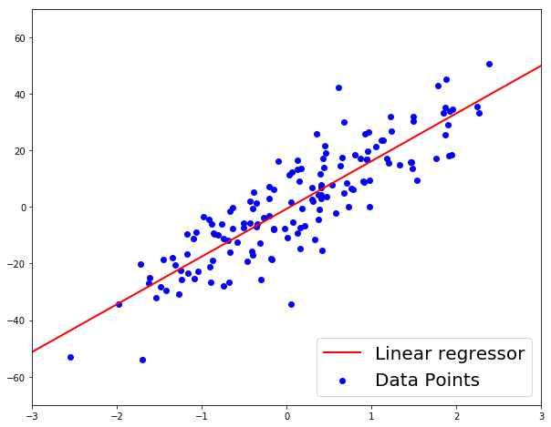
Regression
Regression is a measure of the relationship between some input values (features) and an output value (target).
Regression can be used for prediction of a target variable, the modeling of relationships, and the testing of hypotheses.
There are many different regression techniques.
Ski-Kit learn contains useful modules for regression.

Slide 18
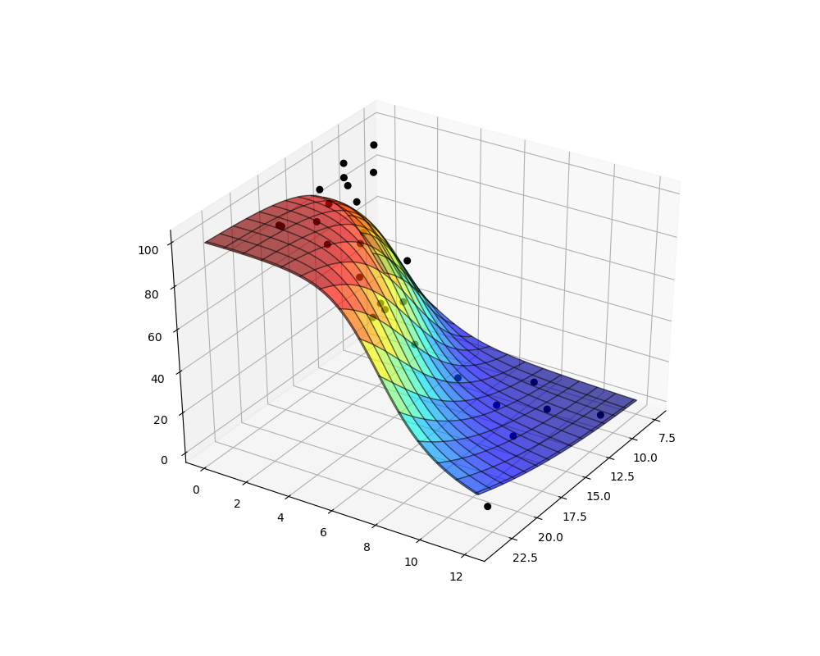
Regression
Regression becomes very useful when the dataset being dealt with is large or there are many features to it.
In a linear regression model, n variables satisfy a linear relationship,
y = β₀ + β₁x₁ + β₂x₂ + … + β_{n}x_{n} + ε_{i}
where the coefficients β are unknown and ε_{i} are random error terms.
By fitting a dataset, the β coefficients can be found and a model made.

Slide 19
Preprocessing
Preprocessing is the processing of data before modeling or analysis such that it is gotten into a ready state to be worked on.
An example of preprocessing was seen earlier in the first classification exercise, where the texture of the fruit was given as a string and had to be converted to a binary number.
Other preprocessing includes the splitting of data into training and testing sets and normalisation of the data.
More about preprocessing can be found on the scikit-learn website: http://scikit-learn.org/stable/modules/preprocessing.html#preprocessing

Slide 20

Underfiitting and Overfitting
If underfitted a model will not be good at making predictions.
If overfitted a model has been trained too much on one dataset and while it will good accuracy for that set, for other sets it will not have good accuracy.
One way to reduce overfitting is to only include features in a dataset that are believed to have a significant impact on the target.
https://stats.stackexchange.com/questions/192007/what-measures-you-look-at-the-determine-over-fitting-in-linear-regression/192021

Slide 21
Scikit-Learn and Regression
Scikit-learn makes linear regression very simple.
Import the linear_model module from sklearn, choose which linear model to use, fit the data to it, analyse and test the results.
In scikit-learn there are a number of regression techniques available, including linear, lasso, and ridge regression.
The linear regression techniques can be found under sklearn.linear_model
Scikit-learn comes with some built in dataset which can be found under sklearn.datasets

Slide 22
Regression and Decision Trees
When the target in a dataset is discrete the problem is one of classification.
When the target in a dataset is continuous then the problem is one of prediction.
It was seen how decision trees were used to classify the type of iris species.
Decision trees can be used continuous targets to predict values and the importance of each feature.

Slide 23
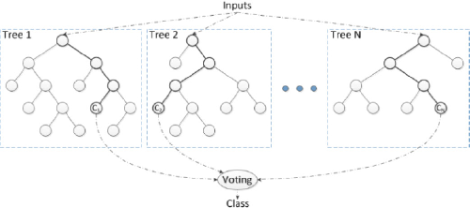
Extra Tree Regressor
To help improve accuracy for decision trees with regression and extra tree regressor can be used.
An extra tree regressor fits a number of randomised trees on different subsamples of the dataset and averages them to improve the accuracy and to control overfitting.
When an optimal selection of features is chosen the Extra Tree performs as well as the Random Forest, though in general is computationally faster.
https://wwrchgate.net/301243118_fig4_Figure-6-Random-Forest-Modelw.resea

Slide 24
Feature Importance and Metrics
Extra Trees are hard to visualise as there’s typically a large number of trees.
Instead, useful information such as feature importance can be extracted.
Feature importance gives a score to each feature that is a measure of how much they affect the target.
To gauge the accuracy metrics such as the R-squared value can be used.
Feature importance and the R-squared values are easy to extract in scikit-learn.

Slide 25
Regression Practical
An example of linear regression analysis using scikit-learn and Python can be found in the ‘RegressionPractical’ Jupyter Notebook, located in the ‘Practical_2’ directory.
Follow through the regression analysis in this Notebook and perform the same regression analysis for the Boston dataset found in scikit-learn.

Slide 26
Regression Summary
Regression can be used to find the relationship between a target variable and feature variables.
It can also be used to predict values of the target variable for given feature values.
Decision trees can be used to make a regression model.
Feature importances can be found for a given model.

Slide 27
Image Classifier With TensorFlow
Overview
Basic Introduction to Deep-learning
TensorFlow for Poets
Practical 1
Practical 2

Slide 28
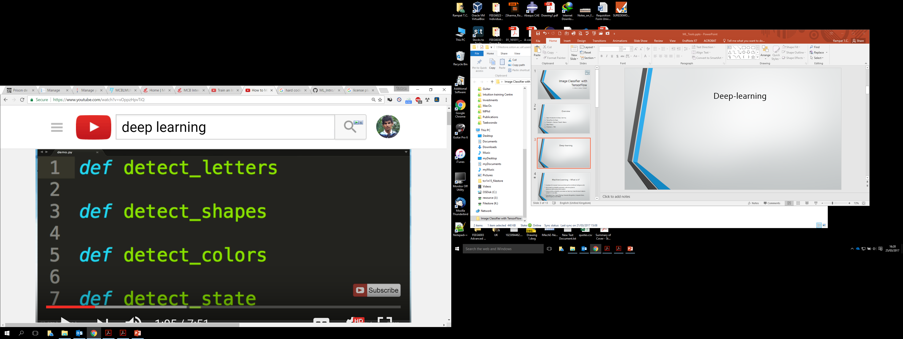
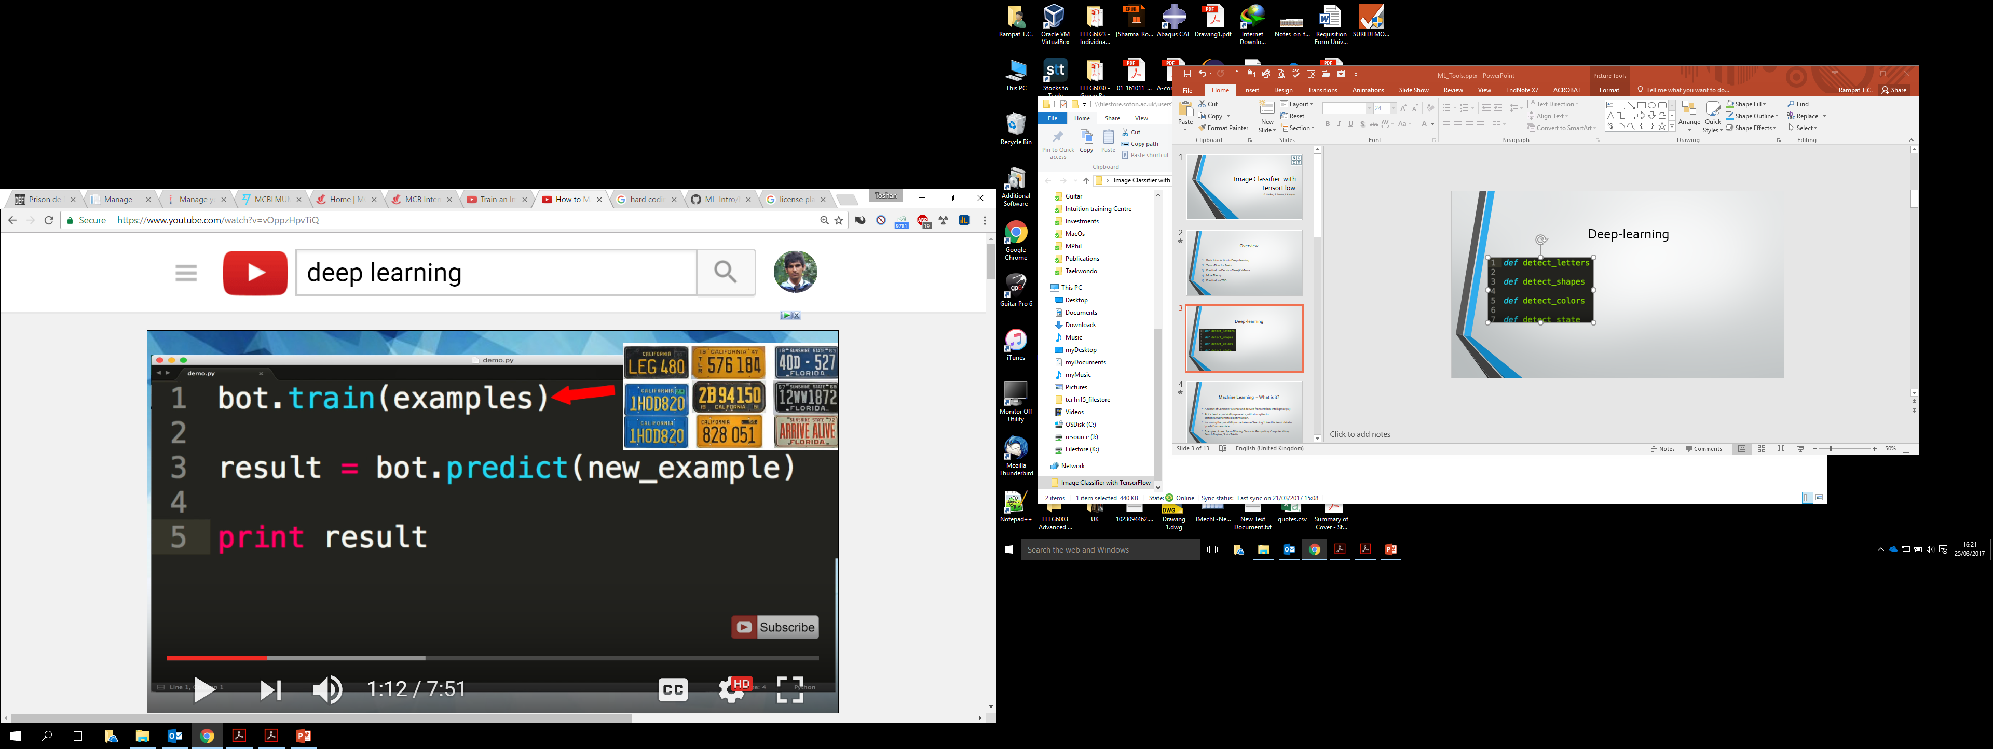

Deep-Learning
Hard Coding
Machine-Learning
Recap:
Supervised: Feedback every time – (Practical 1)
Unsupervised: No feedback, learns by itself
Reinforced learning: Feedback if positive(trial and error) – Practical 2
E.G License plate

Slide 29

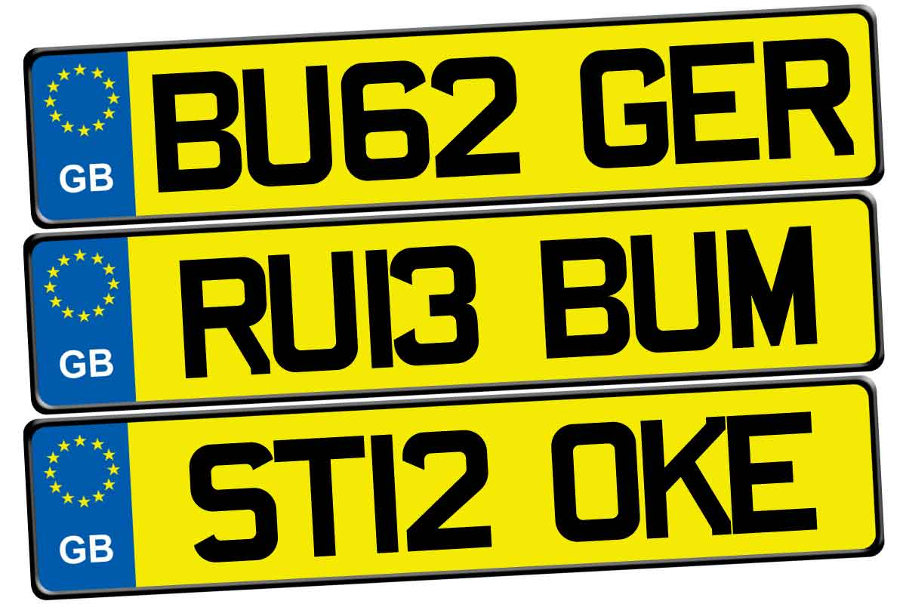

Neural Network
License plate UK
f(complex_0)
f(complex_1)
f(complex_2)
…
License plate FR
f(complex_3)
http://playground.tensorflow.org/

Slide 30


Slide 31

What is TensorFlow?
TensorFlow is a deep learning library recently open-sourced by Google.
But what does it actually do?
TensorFlow provides primitives for defining functions on tensors and automatically computing their derivatives.
http://playground.tensorflow.org/

Slide 32
Practical 1 - Supervised
https://codelabs.developers.google.com/codelabs/tensorflow-for-poets/?utm_campaign=chrome_series_machinelearning_063016&utm_source=gdev&utm_medium=yt-desc#0

Slide 33


Practical 2
What about a game using reinforcement learning?
Input Output
Maximise the score
Raw Pixel
https://github.com/HackerHouseYT/OpenAI-NEAT

Slide 34
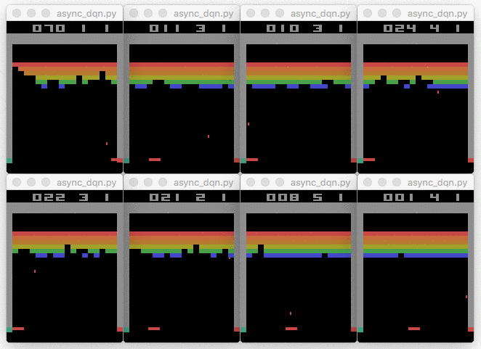

Slide 35
Deep-Learning Summary
A deep neural network (DNN) is an artificial neural network (ANN) with multiple hidden layers of units between the input and output layers.
Computational deep learning is closely related to a class of theories of brain development.
Computer A.I use deep learning to understand how users interact.

Slide 36
Summary
Machine learning is a wide ranging topic that focuses on learning from large datasets.
Data from discrete types of input can be classified using decision trees.
Regression can be used to find relationships in datasets and to make predictions.
TensorFlow can be used for image classification.
This work was supported by an EPSRC Doctoral Training Centre grant (EP/L015382/1)

Slide 37
Further Resources
The scikit-learn website: www.scikit-learn.org
The tensorflow website: www.tensorflow.org
A YouTube series on making a basic neural network: https://goo.gl/uvhELR
A YouTube series on Machine Learning (inspiration): https://www.youtube.com/watch?v=cKxRvEZd3Mw

